Slide 1
Credit Card, Office Sales Analysis, Bank Balance Analysis in PowerBI

Slide 2
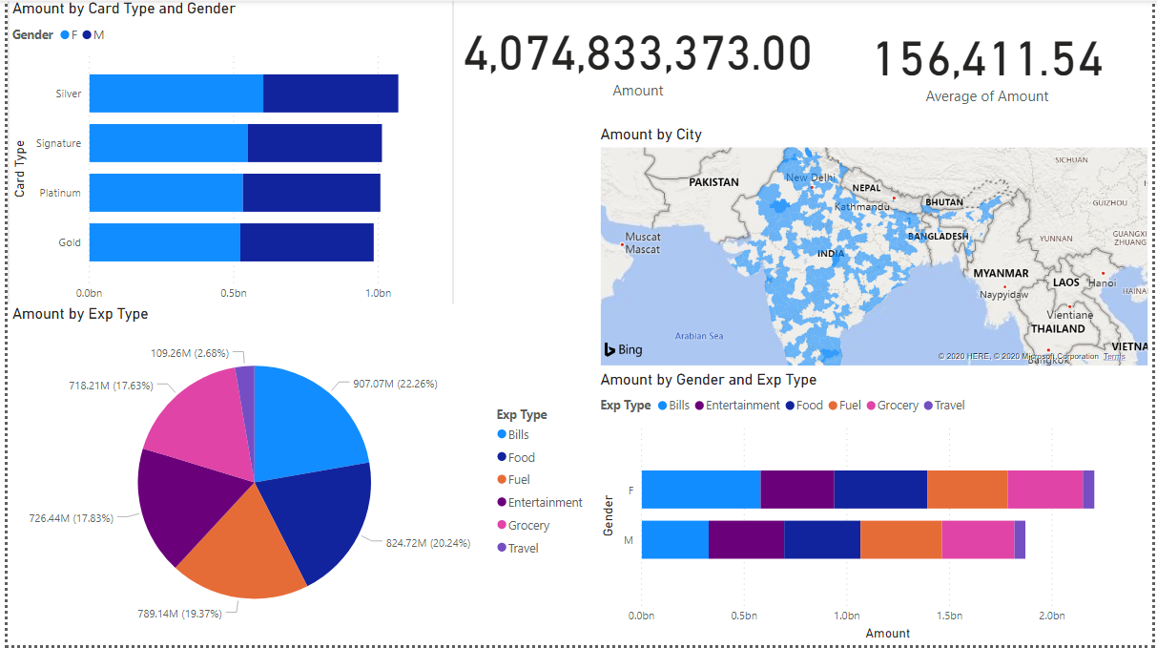

Slide 3
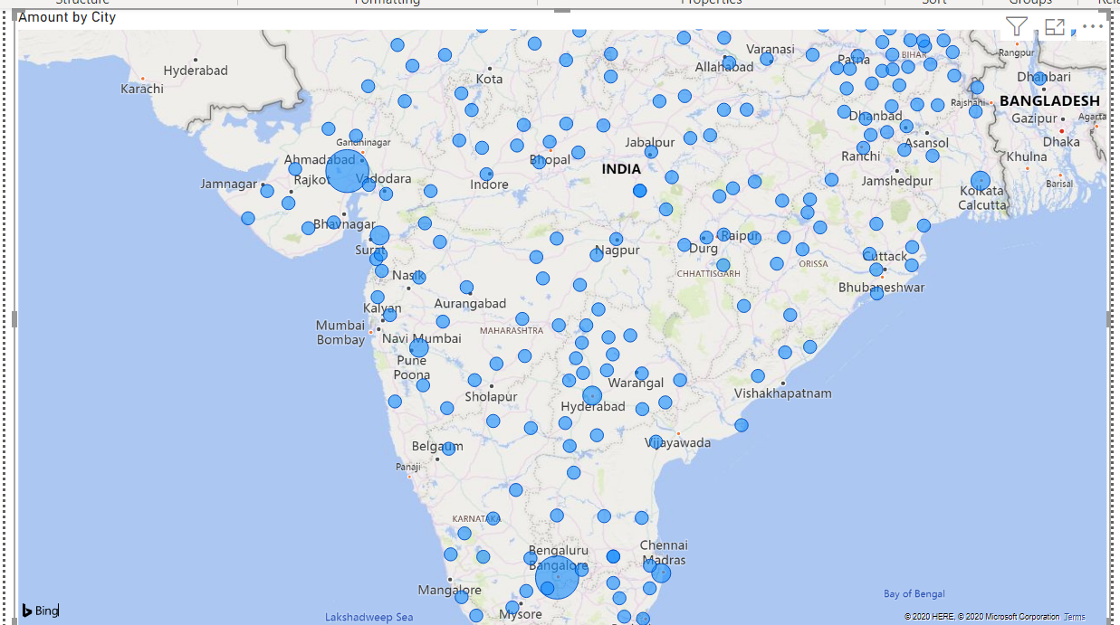
Credit Card utilization by city

Slide 4
Credit Card Analysis
Comparing all the expenses incurred, Bills have largest expenses (22.26%), followed by food (20.24%) and then fuel (19.37%).
Silver is the largest utilized card followed by Signature, Platinum and then Gold.
For all the cards, females have incurred more expenses as compared to males except fuel, where males have marginally higher expenses.
Bengaluru has highest expense as compared to all other cities for credit card utilization amount.

Slide 5
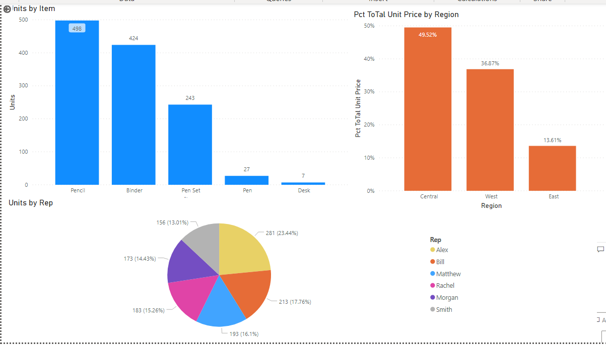
Office Supplies Analysis

Slide 6
Office supplies sales analysis
Percent of total unit price is 49.52% for Central region which is more than West and East by 12.65% and 35.91%.
Units by item chart shows the distribution of item by units with region as filter
Binder and pencils have more unit sales than pen, pen set and Desk.
Pie chart represents distribution of units by representative with filters of region.
Pct of total unit price by region represents percent of total unit price.
DAX formula used: Pct ToTal Balance = DIVIDE(SUM('P6-OfficeSupplies'[Unit Price]), CALCULATE(SUM('P6-OfficeSupplies'[Unit Price]),ALLSELECTED(('P6-OfficeSupplies'))))

Slide 7
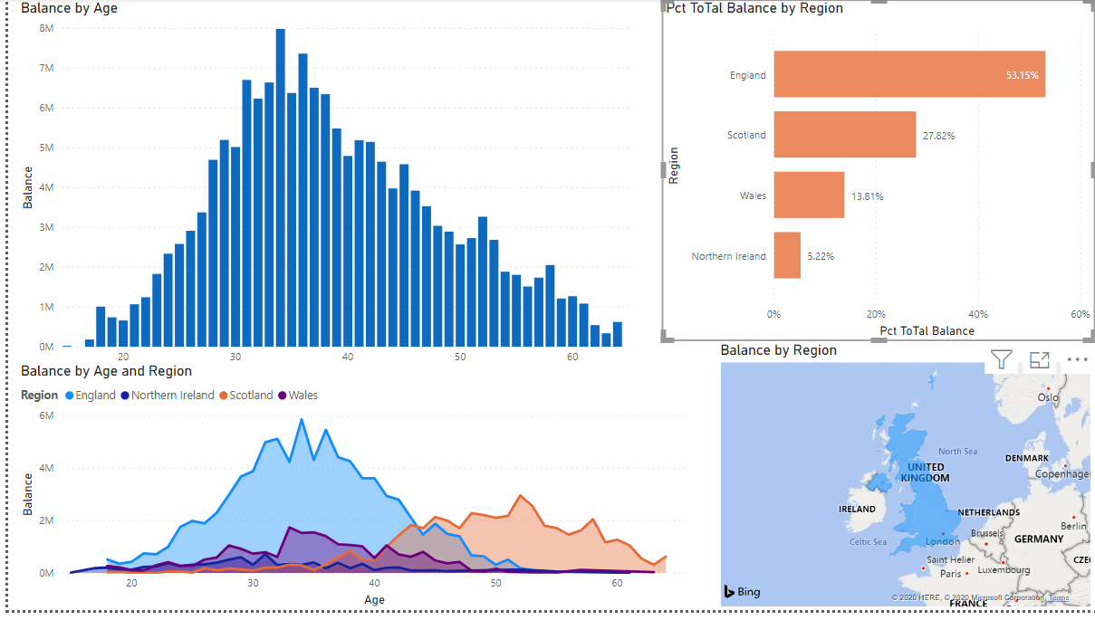
UK Bank Customer Analysis

Slide 8
UK Bank Customer
Balance by age is a histogram distribution where the balances of customers are distributed according to the age. Age range from 30 to 40 have largest unpaid balances.
Percent of balance by region represents % of balance distributed by region.
DAX formula utilized: Pct ToTal Balance = DIVIDE(SUM('P6-UK-Bank-Customers'[Balance]), CALCULATE(SUM('P6-UK-Bank-Customers'[Balance]),ALLSELECTED(('P6-UK-Bank-Customers'))))
England has largest balance of 53.15%.
Balance by Age and region represents the area chart.
Balance by region is a map.

Slide 9
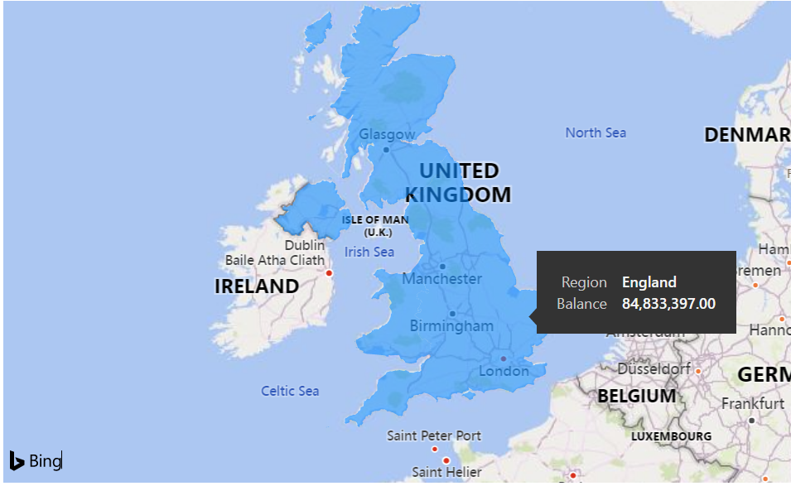
England has largest Balance

Slide 10
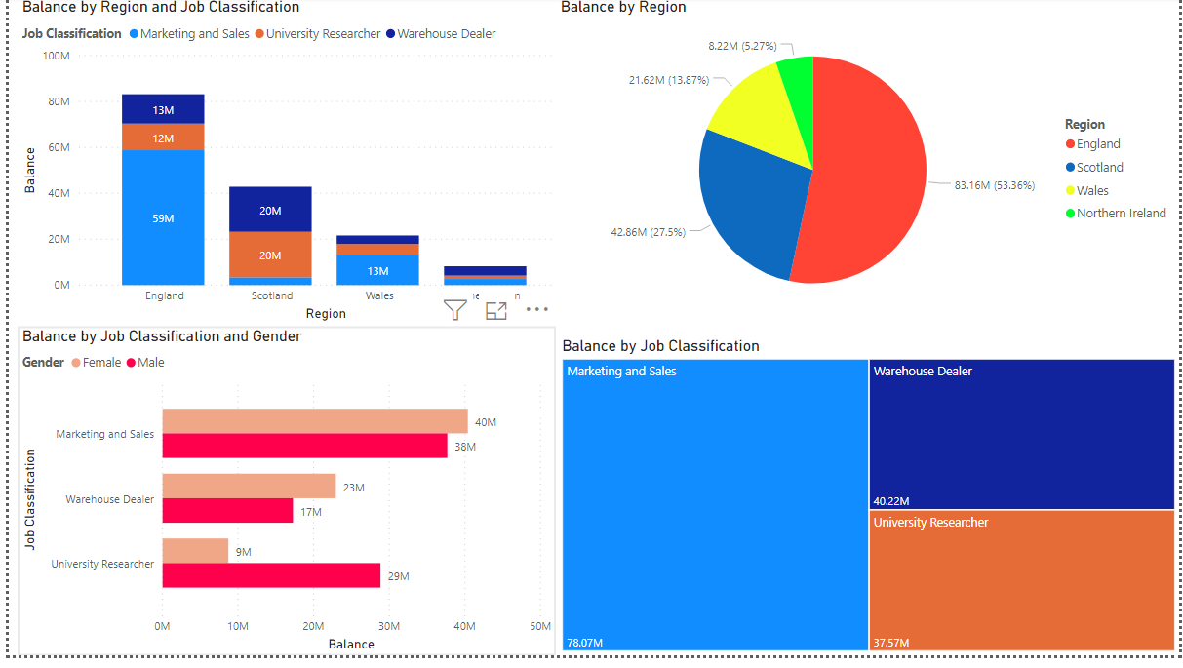
Balances by region and job classification

Slide 11
Balance Analysis
England has largest balances. Customers with Marketing and Sales occupations have largest balances.
Females have largest balances than males in marketing and sales and warehouse dealerships.
Balance by region is a pie chart with balance percentages. England has largest while Northern Ireland has lowest percentage.

